Slide 1


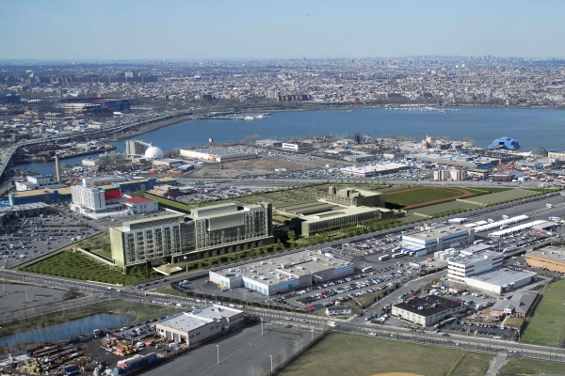
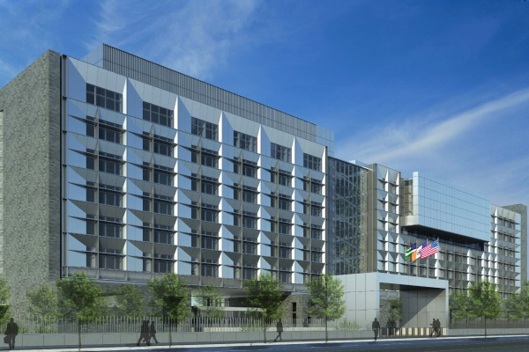
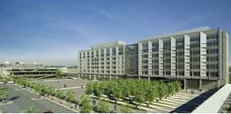
New York Police Academy
College Point, New York
John M. Scavelli Mechanical Option Senior Thesis 2010-2011
The Pennsylvania State University: Department of Architectural Engineering
Master/Bachelor of Architectural Engineering Student

Slide 2
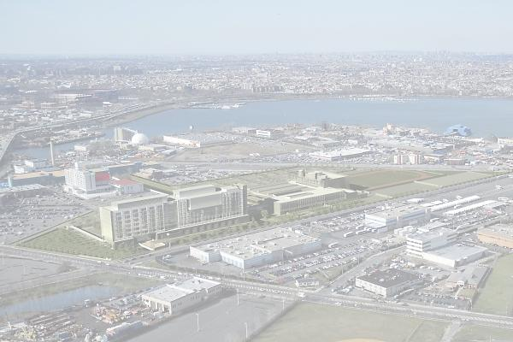
Introduction
Presentation Outline
  Introduction
Location, Statistics, General Information
John M. Scavelli
The Pennsylvania State University
Architectural Engineering
Mechanical Option
Master of Architectural Engineering
Bachelor of Architectural Engineering
Thesis Advisor: Dr. William Bahnfleth
Presentation Plan
New York Police Academy
College Point, New York
John M. Scavelli Mechanical Option Senior Thesis 2010-2011
The Pennsylvania State University: Department of Architectural Engineering
Master/Bachelor of Architectural Engineering Student

Slide 3
Introduction
Presentation Outline
  Introduction
Location, Statistics, General Information
  Actual Mechanical Design
System, Loads, Utility Costs
John M. Scavelli
The Pennsylvania State University
Architectural Engineering
Mechanical Option
Master of Architectural Engineering
Bachelor of Architectural Engineering
Thesis Advisor: Dr. William Bahnfleth
Presentation Plan
New York Police Academy
College Point, New York
John M. Scavelli Mechanical Option Senior Thesis 2010-2011
The Pennsylvania State University: Department of Architectural Engineering
Master/Bachelor of Architectural Engineering Student

Slide 4
Introduction
Presentation Outline
  Introduction
Location, Statistics, General Information
  Actual Mechanical Design
System, Loads, Utility Costs
  Alternative Design
Mechanical Depth: GSHP
Electrical Breadth: PV Array
Construction Breadth: Cost Analysis
John M. Scavelli
The Pennsylvania State University
Architectural Engineering
Mechanical Option
Master of Architectural Engineering
Bachelor of Architectural Engineering
Thesis Advisor: Dr. William Bahnfleth
Presentation Plan
New York Police Academy
College Point, New York
John M. Scavelli Mechanical Option Senior Thesis 2010-2011
The Pennsylvania State University: Department of Architectural Engineering
Master/Bachelor of Architectural Engineering Student

Slide 5
Introduction
Presentation Outline
  Introduction
Location, Statistics, General Information
  Actual Mechanical Design
System, Loads, Utility Costs
  Alternative Design
Mechanical Depth: GSHP
Electrical Breadth: PV Array
Construction Breadth: Cost Analysis
  The Final Analysis
Integration of Depths & Breadths
Final Recommendation
John M. Scavelli
The Pennsylvania State University
Architectural Engineering
Mechanical Option
Master of Architectural Engineering
Bachelor of Architectural Engineering
Thesis Advisor: Dr. William Bahnfleth
Presentation Plan
New York Police Academy
College Point, New York
John M. Scavelli Mechanical Option Senior Thesis 2010-2011
The Pennsylvania State University: Department of Architectural Engineering
Master/Bachelor of Architectural Engineering Student

Slide 6
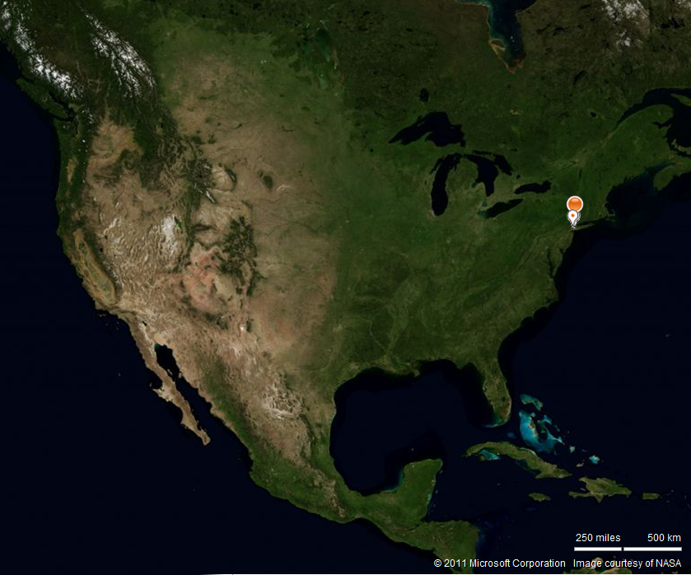
Building Location
Presentation Outline
  Introduction
Location, Statistics, General Information
  Actual Mechanical Design
System, Loads, Utility Costs
  Alternative Design
Mechanical Depth: GSHP
Electrical Breadth: PV Array
Construction Breadth: Cost Analysis
  The Final Analysis
Integration of Depths & Breadths
Final Recommendation
Location
College Point, New York
North Eastern Part of the United States of America
John M. Scavelli Mechanical Option Senior Thesis 2010-2011
The Pennsylvania State University: Department of Architectural Engineering
Master/Bachelor of Architectural Engineering Student

Slide 7
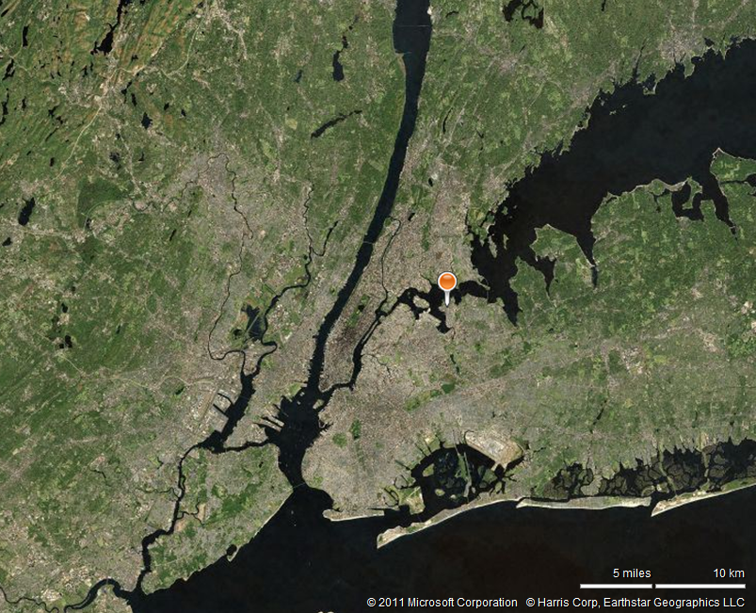
Building Location
Presentation Outline
  Introduction
Location, Statistics, General Information
  Actual Mechanical Design
System, Loads, Utility Costs
  Alternative Design
Mechanical Depth: GSHP
Electrical Breadth: PV Array
Construction Breadth: Cost Analysis
  The Final Analysis
Integration of Depths & Breadths
Final Recommendation
Location
College Point, New York
Close Proximity to Manhattan, NY
NYPA
Manhattan
John M. Scavelli Mechanical Option Senior Thesis 2010-2011
The Pennsylvania State University: Department of Architectural Engineering
Master/Bachelor of Architectural Engineering Student

Slide 8
Building Location
Location
College Point, New York
Presentation Outline
  Introduction
Location, Statistics, General Information
  Actual Mechanical Design
System, Loads, Utility Costs
  Alternative Design
Mechanical Depth: GSHP
Electrical Breadth: PV Array
Construction Breadth: Cost Analysis
  The Final Analysis
Integration of Depths & Breadths
Final Recommendation
John M. Scavelli Mechanical Option Senior Thesis 2010-2011
The Pennsylvania State University: Department of Architectural Engineering
Master/Bachelor of Architectural Engineering Student

Slide 9
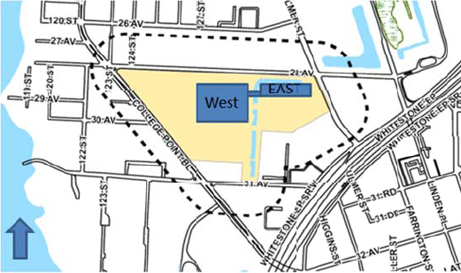
Building Statistics
Presentation Outline
  Introduction
Location, Statistics, General Information
  Actual Mechanical Design
System, Loads, Utility Costs
  Alternative Design
Mechanical Depth: GSHP
Electrical Breadth: PV Array
Construction Breadth: Cost Analysis
  The Final Analysis
Integration of Depths & Breadths
Final Recommendation
Occupant: New York Police Department
Architect: Perkins + Will
Site Size: 2,400,000 SF
Building Size: 840,400 SF
Overall Cost: $656,000,000
East Campus: Academic/Office Space
  375,405 SF
West Campus: Physical Fitness/ Central Plant
  465,000 SF
Architecture: Modern w/ Strong Geometric Forms
John M. Scavelli Mechanical Option Senior Thesis 2010-2011
The Pennsylvania State University: Department of Architectural Engineering
Master/Bachelor of Architectural Engineering Student

Slide 10
General Information
Presentation Outline
  Introduction
Location, Statistics, General Information
  Actual Mechanical Design
System, Loads, Utility Costs
  Alternative Design
Mechanical Depth: GSHP
Electrical Breadth: PV Array
Construction Breadth: Cost Analysis
  The Final Analysis
Integration of Depths & Breadths
Final Recommendation
General Construction Information
General Electrical Information
Turner Construction Company and STV Inc. will lead as joint General Contractors.
New York Department of Design and Construction will be responsible for overseeing the progression of the project.
Electrical Engineers: WSP Flack + Kurtz
460/265V 3-Phase High Voltage system stepped down to 120/208 V 3-Phase Low Voltage System
General Mechanical Information
General Structural Information
Mechanical Engineers: WSP Flack + Kurtz
Centralized Heating and Cooling Plant System
Structural Engineers : Robert Silman Associates
Steel Super Structure
John M. Scavelli Mechanical Option Senior Thesis 2010-2011
The Pennsylvania State University: Department of Architectural Engineering
Master/Bachelor of Architectural Engineering Student

Slide 11
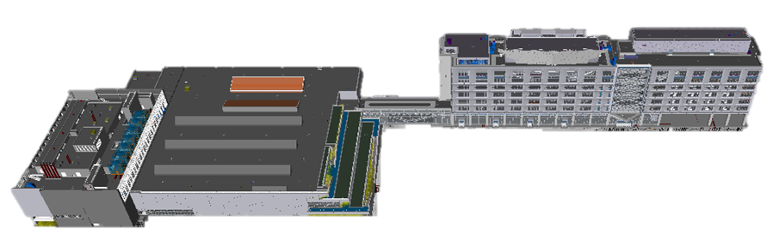
Mechanical Systems Overview
Ventilation Needs
  63 Air Handling Units-3,000-30,000 CFM
    18-Central Plant
    26-West Campus
    19-East Campus
Central Plant-Heating and Cooling
  6- 1350 Ton Electric Centrifugal Chillers
    2 Installed for future expansion
  6- Induced Draft Cooling Towers
    3 Installed for future expansion
  5-25110 MBH Natural Gas Water Tube Boilers
    2 Installed for Future expansion
Presentation Outline
  Introduction
Location, Statistics, General Information
  Actual Mechanical Design
System, Loads, Utility Costs
  Alternative Design
Mechanical Depth: GSHP
Electrical Breadth: PV Array
Construction Breadth: Cost Analysis
  The Final Analysis
Integration of Depths & Breadths
Final Recommendation
West Campus
East Campus
Central Plant
John M. Scavelli Mechanical Option Senior Thesis 2010-2011
The Pennsylvania State University: Department of Architectural Engineering
Master/Bachelor of Architectural Engineering Student

Slide 12
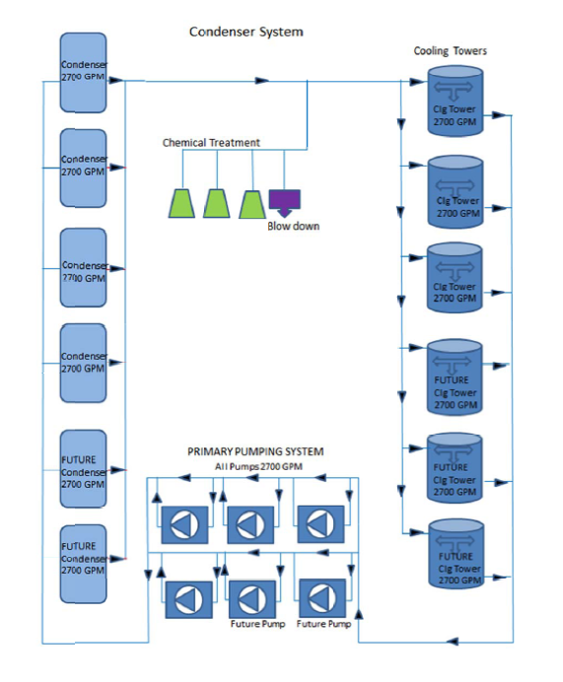
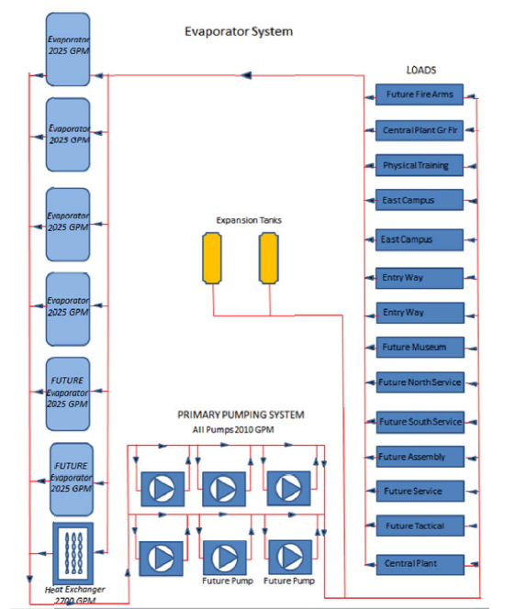
Mechanical Systems Overview
Ventilation Needs
  63 Air Handling Units-3,000-30,000 CFM
    18-Central Plant
    26-West Campus
    19-East Campus
Central Plant-Heating and Cooling
  6- 1350 Ton Electric Centrifugal Chillers
    2 Installed for future expansion
  6- Induced Draft Cooling Towers
    3 Installed for future expansion
  5-25110 MBH Natural Gas Water Tube Boilers
    2 Installed for Future expansion
Presentation Outline
  Introduction
Location, Statistics, General Information
  Actual Mechanical Design
System, Loads, Utility Costs
  Alternative Design
Mechanical Depth: GSHP
Electrical Breadth: PV Array
Construction Breadth: Cost Analysis
  The Final Analysis
Integration of Depths & Breadths
Final Recommendation
John M. Scavelli Mechanical Option Senior Thesis 2010-2011
The Pennsylvania State University: Department of Architectural Engineering
Master/Bachelor of Architectural Engineering Student

Slide 13
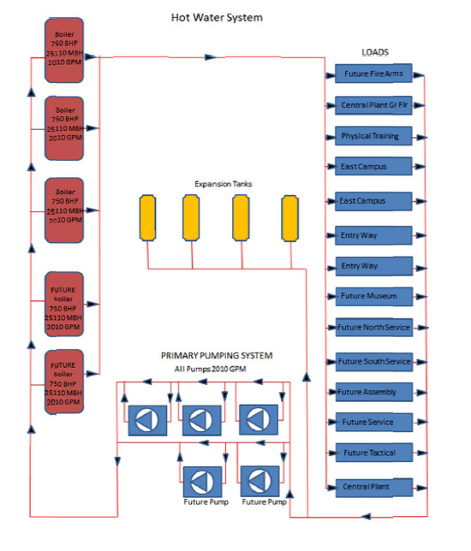
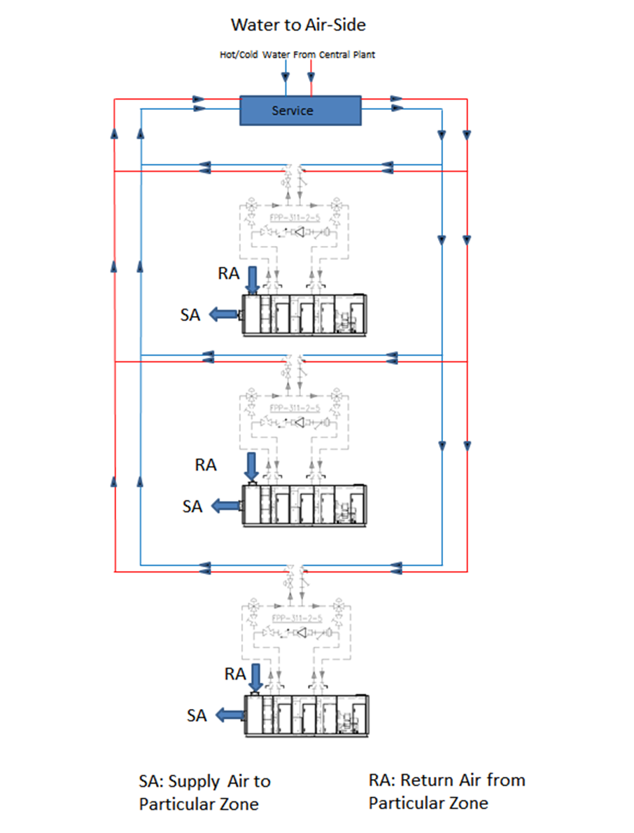
Mechanical Systems Overview
Ventilation Needs
  63 Air Handling Units-3,000-30,000 CFM
    18-Central Plant
    26-West Campus
    19-East Campus
Central Plant-Heating and Cooling
  6- 1350 Ton Electric Centrifugal Chillers
    2 Installed for future expansion
  6- Induced Draft Cooling Towers
    3 Installed for future expansion
  5-25110 MBH Natural Gas Water Tube Boilers
    2 Installed for Future expansion
Presentation Outline
  Introduction
Location, Statistics, General Information
  Actual Mechanical Design
System, Loads, Utility Costs
  Alternative Design
Mechanical Depth: GSHP
Electrical Breadth: PV Array
Construction Breadth: Cost Analysis
  The Final Analysis
Integration of Depths & Breadths
Final Recommendation
John M. Scavelli Mechanical Option Senior Thesis 2010-2011
The Pennsylvania State University: Department of Architectural Engineering
Master/Bachelor of Architectural Engineering Student

Slide 14
East Campus Building Loads
Presentation Outline
  Introduction
Location, Statistics, General Information
  Actual Mechanical Design
System, Loads, Utility Costs
  Alternative Design
Mechanical Depth: GSHP
Electrical Breadth: PV Array
Construction Breadth: Cost Analysis
  The Final Analysis
Integration of Depths & Breadths
Final Recommendation
The East Campus was chosen as the specific building of study.
  East and West Campus essentially two separate buildings
  375,405 SF
TRANE Trace 700 Used
  Location: LaGuardia Airport (1.6 miles from NYPA)
  Block Load Analysis
  52 Zones
John M. Scavelli Mechanical Option Senior Thesis 2010-2011
The Pennsylvania State University: Department of Architectural Engineering
Master/Bachelor of Architectural Engineering Student

Slide 15
East Campus Energy Consumption
Presentation Outline
  Introduction
Location, Statistics, General Information
  Actual Mechanical Design
System, Loads, Utility Costs
  Alternative Design
Mechanical Depth: GSHP
Electrical Breadth: PV Array
Construction Breadth: Cost Analysis
  The Final Analysis
Integration of Depths & Breadths
Final Recommendation
The East Campus was chosen as the specific building of study.
  East and West Campus essentially two separate buildings
  375,405 SF
TRANE Trace 700 Used
  Location: LaGuardia Airport (1.6 miles from NYPA)
  Block Load Analysis
  52 Zones
John M. Scavelli Mechanical Option Senior Thesis 2010-2011
The Pennsylvania State University: Department of Architectural Engineering
Master/Bachelor of Architectural Engineering Student

Slide 16
East Campus Energy Utility Costs
Presentation Outline
  Introduction
Location, Statistics, General Information
  Actual Mechanical Design
System, Loads, Utility Costs
  Alternative Design
Mechanical Depth: GSHP
Electrical Breadth: PV Array
Construction Breadth: Cost Analysis
  The Final Analysis
Integration of Depths & Breadths
Final Recommendation
The East Campus was chosen as the specific building of study.
  East and West Campus essentially two separate buildings
  375,405 SF
TRANE Trace 700 Used
  Location: LaGuardia Airport (1.6 miles from NYPA)
  Block Load Analysis
  52 Zones
John M. Scavelli Mechanical Option Senior Thesis 2010-2011
The Pennsylvania State University: Department of Architectural Engineering
Master/Bachelor of Architectural Engineering Student

Slide 17
Alternative Design Proposal
Mechanical Depth:
East Campus
Ground Source Heat Pump System
Electrical Breadth:
Photovoltaic System
Construction Management Breadth:
GSHP Cost, Labor, Schedule Impact
John M. Scavelli Mechanical Option Senior Thesis 2010-2011
The Pennsylvania State University: Department of Architectural Engineering
Master/Bachelor of Architectural Engineering Student

Slide 18
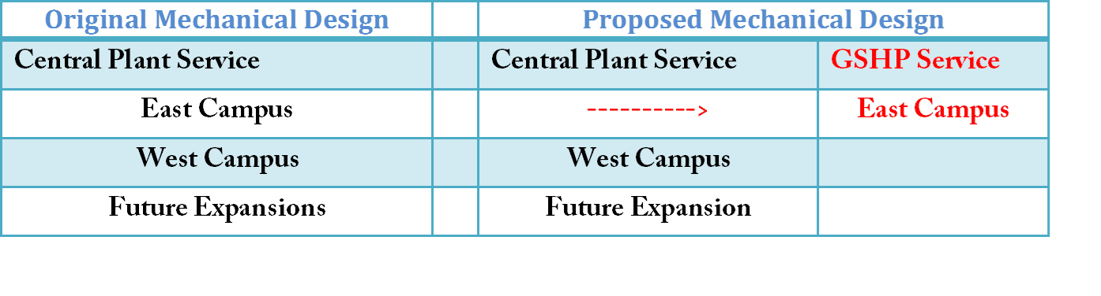
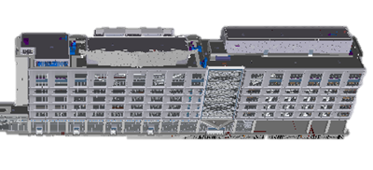
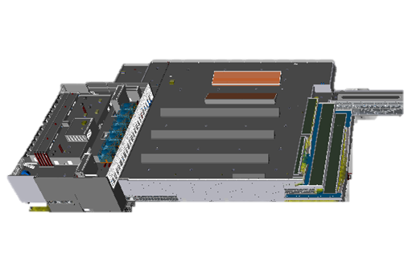
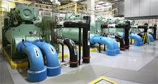
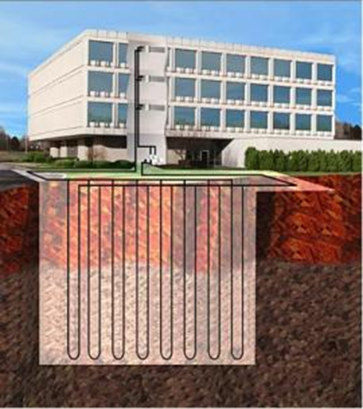
Mechanical Depth Proposal
  Justification
  System Schematics
  Ground Source Heat Pump Loop Sizing
  Energy Modeling
  Utility Cost Comparison
GSHP Major Discussion Topics
Presentation Outline
  Introduction
Location, Statistics, General Information
  Actual Mechanical Design
System, Loads, Utility Costs
  Alternative Design
Mechanical Depth: GSHP
Electrical Breadth: PV Array
Construction Breadth: Cost Analysis
  The Final Analysis
Integration of Depths & Breadths
Final Recommendation
John M. Scavelli Mechanical Option Senior Thesis 2010-2011
The Pennsylvania State University: Department of Architectural Engineering
Master/Bachelor of Architectural Engineering Student

Slide 19
GSHP System Justification
  Justification
  System Schematics
  Ground Source Heat Pump Loop Sizing
  Energy Modeling
  Utility Cost Comparison
GSHP Major Discussion Topics
  Reduce Size of Central Plant yet keep ability for future expansion for West Campus.
    East Campus will not be expanded upon.
  High Electricity Costs in New York
    Reduce Energy Consumption
      Therefore, reduce utility costs and emissions
  New Construction Project
  Large enough site for well field
Presentation Outline
  Introduction
Location, Statistics, General Information
  Actual Mechanical Design
System, Loads, Utility Costs
  Alternative Design
Mechanical Depth: GSHP
Electrical Breadth: PV Array
Construction Breadth: Cost Analysis
  The Final Analysis
Integration of Depths & Breadths
Final Recommendation
John M. Scavelli Mechanical Option Senior Thesis 2010-2011
The Pennsylvania State University: Department of Architectural Engineering
Master/Bachelor of Architectural Engineering Student

Slide 20
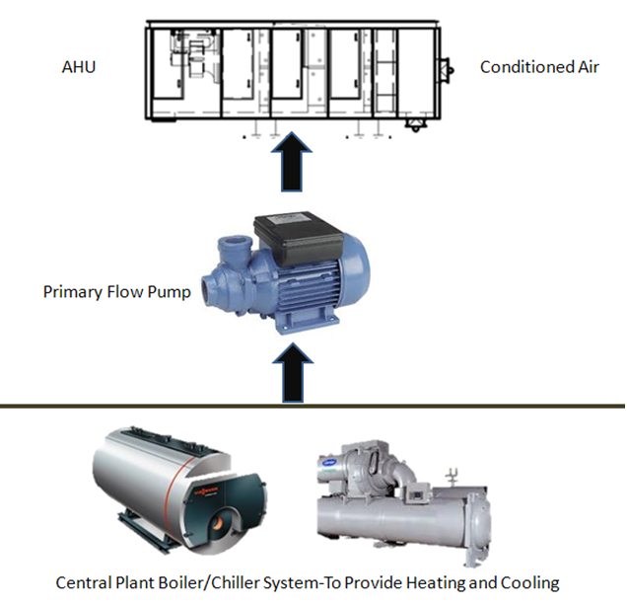
GSHP System Schematics
  Justification
  System Schematics
  Ground Source Heat Pump Loop Sizing
  Energy Modeling
  Utility Cost Comparison
GSHP Major Discussion Topics
Presentation Outline
  Introduction
Location, Statistics, General Information
  Actual Mechanical Design
System, Loads, Utility Costs
  Alternative Design
Mechanical Depth: GSHP
Electrical Breadth: PV Array
Construction Breadth: Cost Analysis
  The Final Analysis
Integration of Depths & Breadths
Final Recommendation
Original Central Plant Design
John M. Scavelli Mechanical Option Senior Thesis 2010-2011
The Pennsylvania State University: Department of Architectural Engineering
Master/Bachelor of Architectural Engineering Student

Slide 21
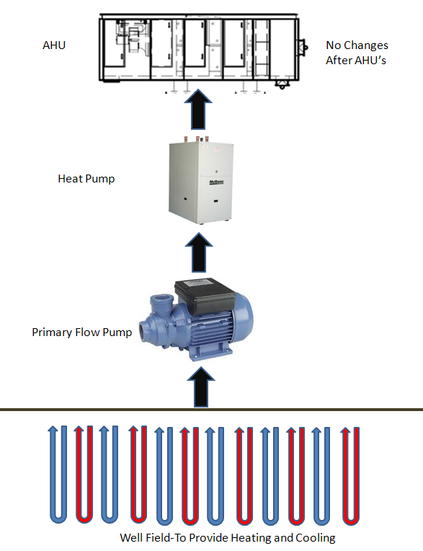
GSHP System Schematics
  Justification
  System Schematics
  Ground Source Heat Pump Loop Sizing
  Energy Modeling
  Utility Cost Comparison
GSHP Major Discussion Topics
Presentation Outline
  Introduction
Location, Statistics, General Information
  Actual Mechanical Design
System, Loads, Utility Costs
  Alternative Design
Mechanical Depth: GSHP
Electrical Breadth: PV Array
Construction Breadth: Cost Analysis
  The Final Analysis
Integration of Depths & Breadths
Final Recommendation
Original Central Plant Design
GSHP Design
John M. Scavelli Mechanical Option Senior Thesis 2010-2011
The Pennsylvania State University: Department of Architectural Engineering
Master/Bachelor of Architectural Engineering Student

Slide 22


GSHP Loop Sizing
  Justification
  System Schematics
  Ground Source Heat Pump Loop Sizing
  Energy Modeling
  Utility Cost Comparison
GSHP Major Discussion Topics
Presentation Outline
  Introduction
Location, Statistics, General Information
  Actual Mechanical Design
System, Loads, Utility Costs
  Alternative Design
Mechanical Depth: GSHP
Electrical Breadth: PV Array
Construction Breadth: Cost Analysis
  The Final Analysis
Integration of Depths & Breadths
Final Recommendation
  Calculated using ASHRAE’s Handbook: HVAC Applications (Chapter 32)
  Largest length required would be for cooling: 299,183 ft.
  Cost Optimization of Loop Size( will be discussed under CM Breadth)
John M. Scavelli Mechanical Option Senior Thesis 2010-2011
The Pennsylvania State University: Department of Architectural Engineering
Master/Bachelor of Architectural Engineering Student

Slide 23
Energy Modeling
  Justification
  System Schematics
  Ground Source Heat Pump Loop Sizing
  Energy Modeling
  Utility Cost Comparison
GSHP Major Discussion Topics
Presentation Outline
  Introduction
Location, Statistics, General Information
  Actual Mechanical Design
System, Loads, Utility Costs
  Alternative Design
Mechanical Depth: GSHP
Electrical Breadth: PV Array
Construction Breadth: Cost Analysis
  The Final Analysis
Integration of Depths & Breadths
Final Recommendation
GSHP Design
John M. Scavelli Mechanical Option Senior Thesis 2010-2011
The Pennsylvania State University: Department of Architectural Engineering
Master/Bachelor of Architectural Engineering Student

Slide 24
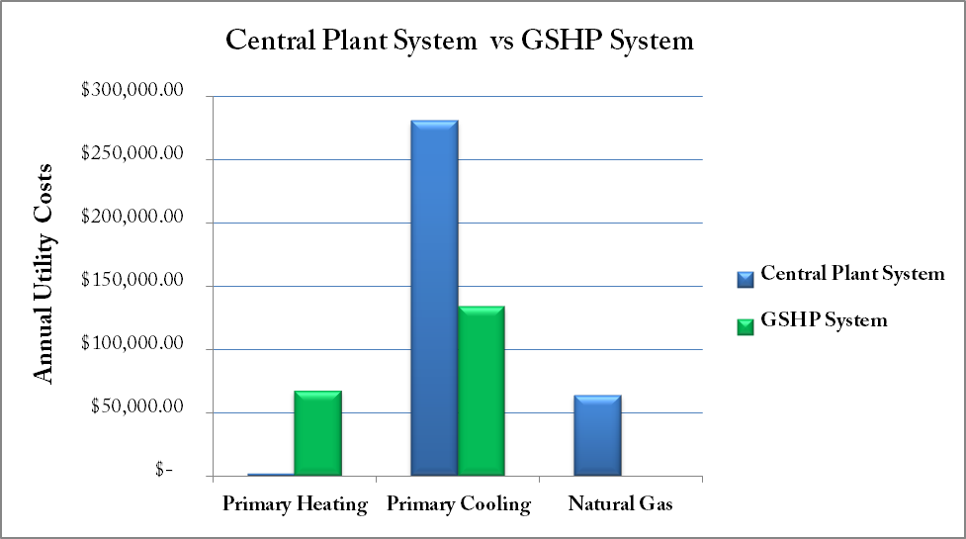
Utility Cost Comparison
  Justification
  System Schematics
  Ground Source Heat Pump Loop Sizing
  Energy Modeling
  Utility Cost Comparison
GSHP Major Discussion Topics
GSHP Design
Presentation Outline
  Introduction
Location, Statistics, General Information
  Actual Mechanical Design
System, Loads, Utility Costs
  Alternative Design
Mechanical Depth: GSHP
Electrical Breadth: PV Array
Construction Breadth: Cost Analysis
  The Final Analysis
Integration of Depths & Breadths
Final Recommendation
  17% Annual Utility Savings
    Electricity + Natural Gas
  Annual Savings: $171,147
    Life Cycle Analysis
  will be evaluated after
  construction (first) costs are
  established
John M. Scavelli Mechanical Option Senior Thesis 2010-2011
The Pennsylvania State University: Department of Architectural Engineering
Master/Bachelor of Architectural Engineering Student

Slide 25
Utility Cost Comparison
  Justification
  System Schematics
  Ground Source Heat Pump Loop Sizing
  Energy Modeling
  Utility Cost Comparison
GSHP Major Discussion Topics
GSHP Design
Presentation Outline
  Introduction
Location, Statistics, General Information
  Actual Mechanical Design
System, Loads, Utility Costs
  Alternative Design
Mechanical Depth: GSHP
Electrical Breadth: PV Array
Construction Breadth: Cost Analysis
  The Final Analysis
Integration of Depths & Breadths
Final Recommendation
  17% Annual Utility Savings
    Electricity + Natural Gas
  Annual Savings: $171,147
    Life Cycle Analysis
  will be evaluated after
  construction (first) costs are
  established
$
$
$
John M. Scavelli Mechanical Option Senior Thesis 2010-2011
The Pennsylvania State University: Department of Architectural Engineering
Master/Bachelor of Architectural Engineering Student

Slide 26
Alternative Design Proposal
Mechanical Depth:
East Campus
Ground Source Heat Pump System
Electrical Breadth:
Photovoltaic System
Construction Management Breadth:
GSHP Cost, Labor, Schedule Impact
  Array Size
  Panel Chosen, Mounting System Chosen
  Electrical Characteristics
    Strings, Inverter, Switchgear
  Economic Analysis
Photovoltaic System Discussion Topics
John M. Scavelli Mechanical Option Senior Thesis 2010-2011
The Pennsylvania State University: Department of Architectural Engineering
Master/Bachelor of Architectural Engineering Student

Slide 27
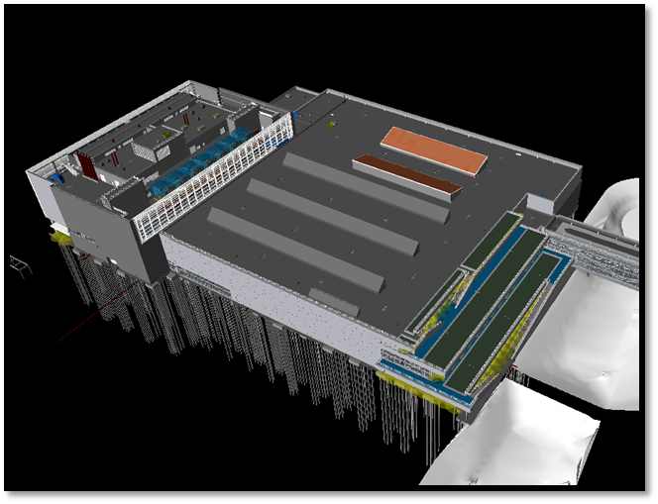
Electrical Breadth Proposal
  Array Size
  Panel Chosen, Mounting System Chosen
  Electrical Characteristics
    Strings, Inverter, Switchgear
  Economic Analysis
Photovoltaic System Discussion Topics
Photovoltaic Array on West Campus Roof
Presentation Outline
  Introduction
Location, Statistics, General Information
  Actual Mechanical Design
System, Loads, Utility Costs
  Alternative Design
Mechanical Depth: GSHP
Electrical Breadth: PV Array
Construction Breadth: Cost Analysis
  The Final Analysis
Integration of Depths & Breadths
Final Recommendation
Prior to PV Array
John M. Scavelli Mechanical Option Senior Thesis 2010-2011
The Pennsylvania State University: Department of Architectural Engineering
Master/Bachelor of Architectural Engineering Student

Slide 28
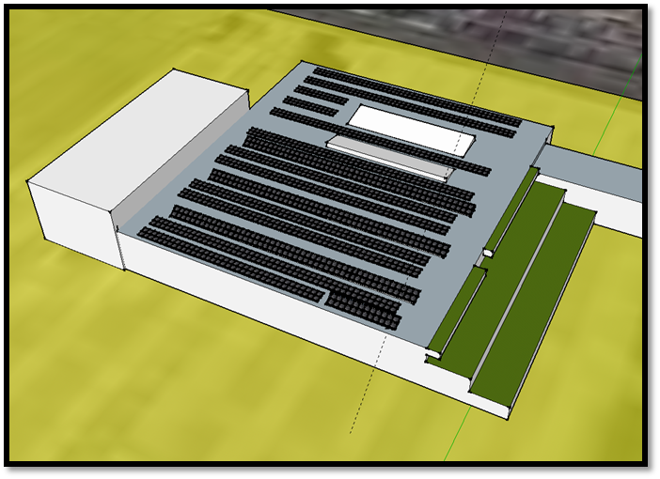
Electrical Breadth Proposal
  Array Size
  Panel Chosen, Mounting System Chosen
  Electrical Characteristics
    Strings, Inverter, Switchgear
  Economic Analysis
Photovoltaic System Discussion Topics
Photovoltaic Array on West Campus Roof
Presentation Outline
  Introduction
Location, Statistics, General Information
  Actual Mechanical Design
System, Loads, Utility Costs
  Alternative Design
Mechanical Depth: GSHP
Electrical Breadth: PV Array
Construction Breadth: Cost Analysis
  The Final Analysis
Integration of Depths & Breadths
Final Recommendation
W/ PV Array
Prior to PV Array
John M. Scavelli Mechanical Option Senior Thesis 2010-2011
The Pennsylvania State University: Department of Architectural Engineering
Master/Bachelor of Architectural Engineering Student

Slide 29
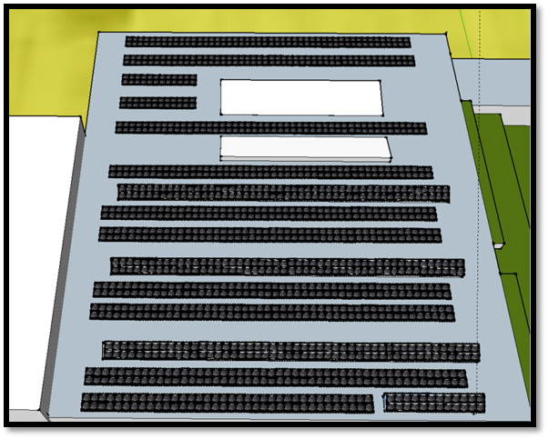
Array Size
  Array Size
  Panel Chosen, Mounting System Chosen
  Electrical Characteristics
    Strings, Inverter, Switchgear
  Economic Analysis
Photovoltaic System Discussion Topics
Presentation Outline
  Introduction
Location, Statistics, General Information
  Actual Mechanical Design
System, Loads, Utility Costs
  Alternative Design
Mechanical Depth: GSHP
Electrical Breadth: PV Array
Construction Breadth: Cost Analysis
  The Final Analysis
Integration of Depths & Breadths
Final Recommendation
John M. Scavelli Mechanical Option Senior Thesis 2010-2011
The Pennsylvania State University: Department of Architectural Engineering
Master/Bachelor of Architectural Engineering Student

Slide 30
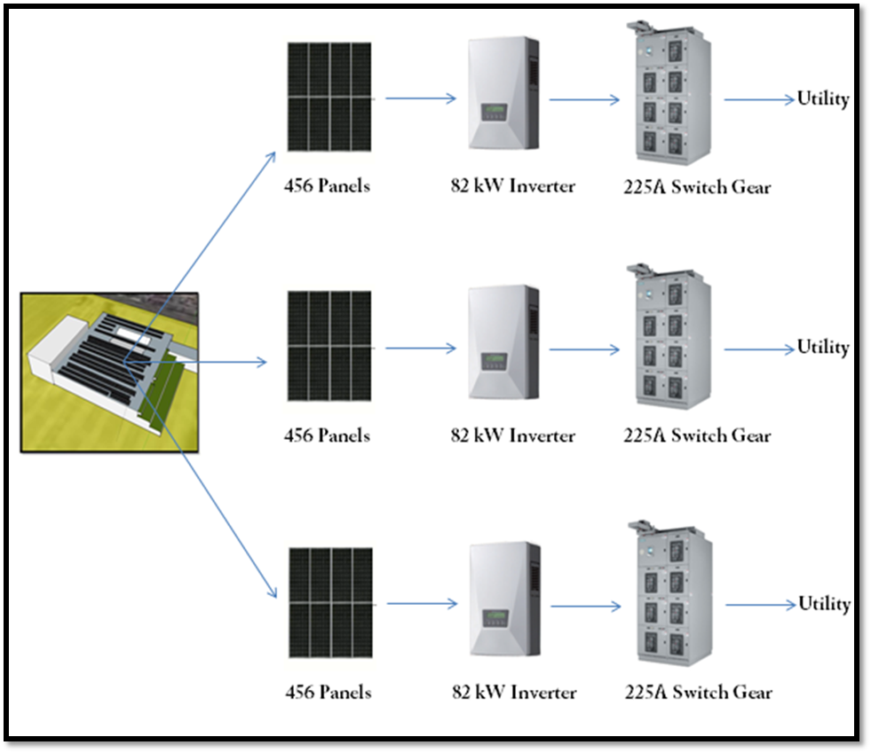
Electrical Characteristics
  Array Size
  Panel Chosen, Mounting System Chosen
  Electrical Characteristics
    Strings, Inverter, Switchgear
  Economic Analysis
Photovoltaic System Discussion Topics
Presentation Outline
  Introduction
Location, Statistics, General Information
  Actual Mechanical Design
System, Loads, Utility Costs
  Alternative Design
Mechanical Depth: GSHP
Electrical Breadth: PV Array
Construction Breadth: Cost Analysis
  The Final Analysis
Integration of Depths & Breadths
Final Recommendation
John M. Scavelli Mechanical Option Senior Thesis 2010-2011
The Pennsylvania State University: Department of Architectural Engineering
Master/Bachelor of Architectural Engineering Student

Slide 31
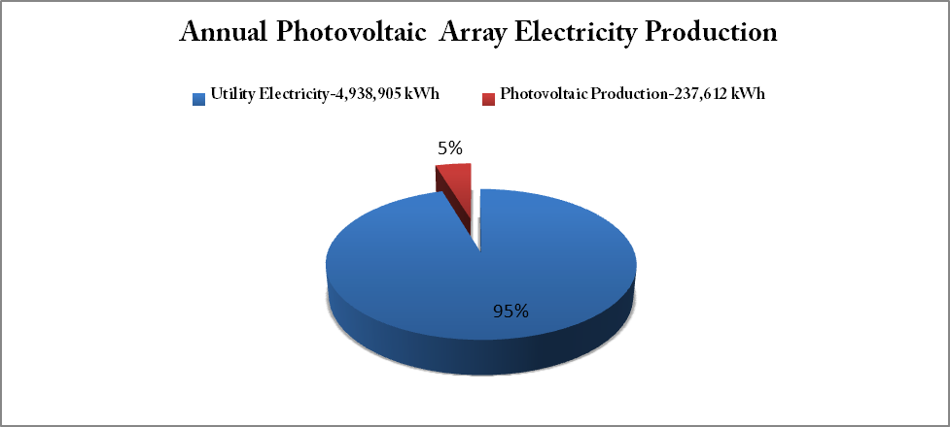
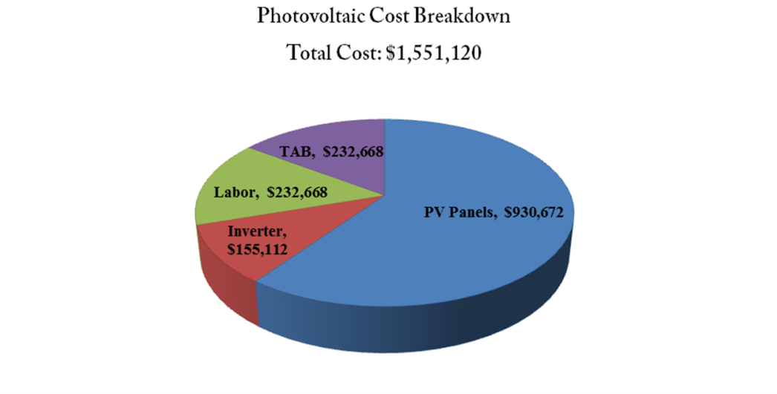
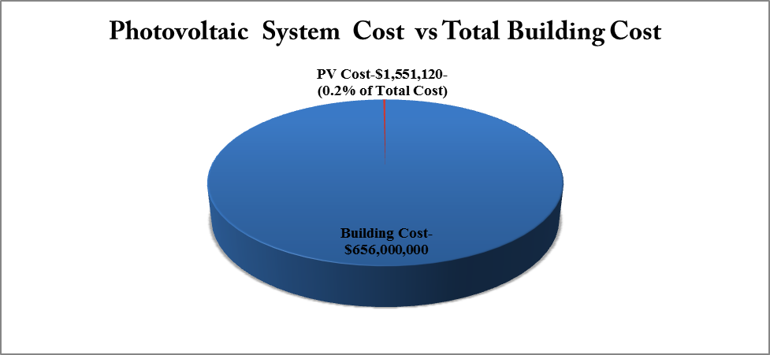
Economic Analysis
  Array Size
  Panel Chosen, Mounting System Chosen
  Electrical Characteristics
    Strings, Inverter, Switchgear
  Economic Analysis
Photovoltaic System Discussion Topics
  5% of Electricity
  0.2% Increase in Cost
Presentation Outline
  Introduction
Location, Statistics, General Information
  Actual Mechanical Design
System, Loads, Utility Costs
  Alternative Design
Mechanical Depth: GSHP
Electrical Breadth: PV Array
Construction Breadth: Cost Analysis
  The Final Analysis
Integration of Depths & Breadths
Final Recommendation
John M. Scavelli Mechanical Option Senior Thesis 2010-2011
The Pennsylvania State University: Department of Architectural Engineering
Master/Bachelor of Architectural Engineering Student

Slide 32
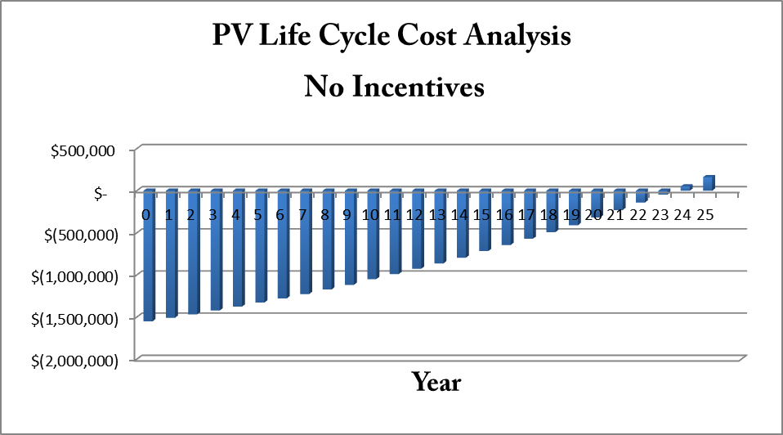
Economic Analysis
  Array Placement
  Array Size
  Panel Chosen, Mounting System Chosen
  Electrical Characteristics
    Strings, Inverter, Switchgear
  Economic Analysis
Photovoltaic System Discussion Topics
Presentation Outline
  Introduction
Location, Statistics, General Information
  Actual Mechanical Design
System, Loads, Utility Costs
  Alternative Design
Mechanical Depth: GSHP
Electrical Breadth: PV Array
Construction Breadth: Cost Analysis
  The Final Analysis
Integration of Depths & Breadths
Final Recommendation
John M. Scavelli Mechanical Option Senior Thesis 2010-2011
The Pennsylvania State University: Department of Architectural Engineering
Master/Bachelor of Architectural Engineering Student

Slide 33
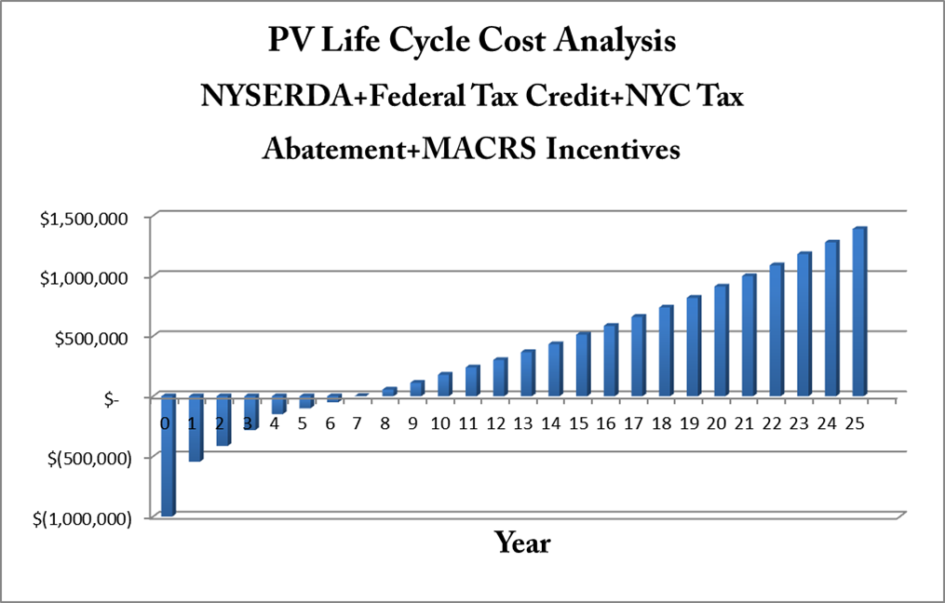
Economic Analysis
  Array Placement
  Array Size
  Panel Chosen, Mounting System Chosen
  Electrical Characteristics
    Strings, Inverter, Switchgear
  Economic Analysis
Photovoltaic System Discussion Topics
Presentation Outline
  Introduction
Location, Statistics, General Information
  Actual Mechanical Design
System, Loads, Utility Costs
  Alternative Design
Mechanical Depth: GSHP
Electrical Breadth: PV Array
Construction Breadth: Cost Analysis
  The Final Analysis
Integration of Depths & Breadths
Final Recommendation
John M. Scavelli Mechanical Option Senior Thesis 2010-2011
The Pennsylvania State University: Department of Architectural Engineering
Master/Bachelor of Architectural Engineering Student

Slide 34
Alternative Design Proposal
Mechanical Depth:
East Campus
Ground Source Heat Pump System
Electrical Breadth:
Photovoltaic System
Construction Management Breadth:
GSHP Cost, Labor, Schedule Impact
  Length Optimization
  Construction Cost
  Life Cycle Cost Analysis
Construction Discussion Topics
John M. Scavelli Mechanical Option Senior Thesis 2010-2011
The Pennsylvania State University: Department of Architectural Engineering
Master/Bachelor of Architectural Engineering Student

Slide 35
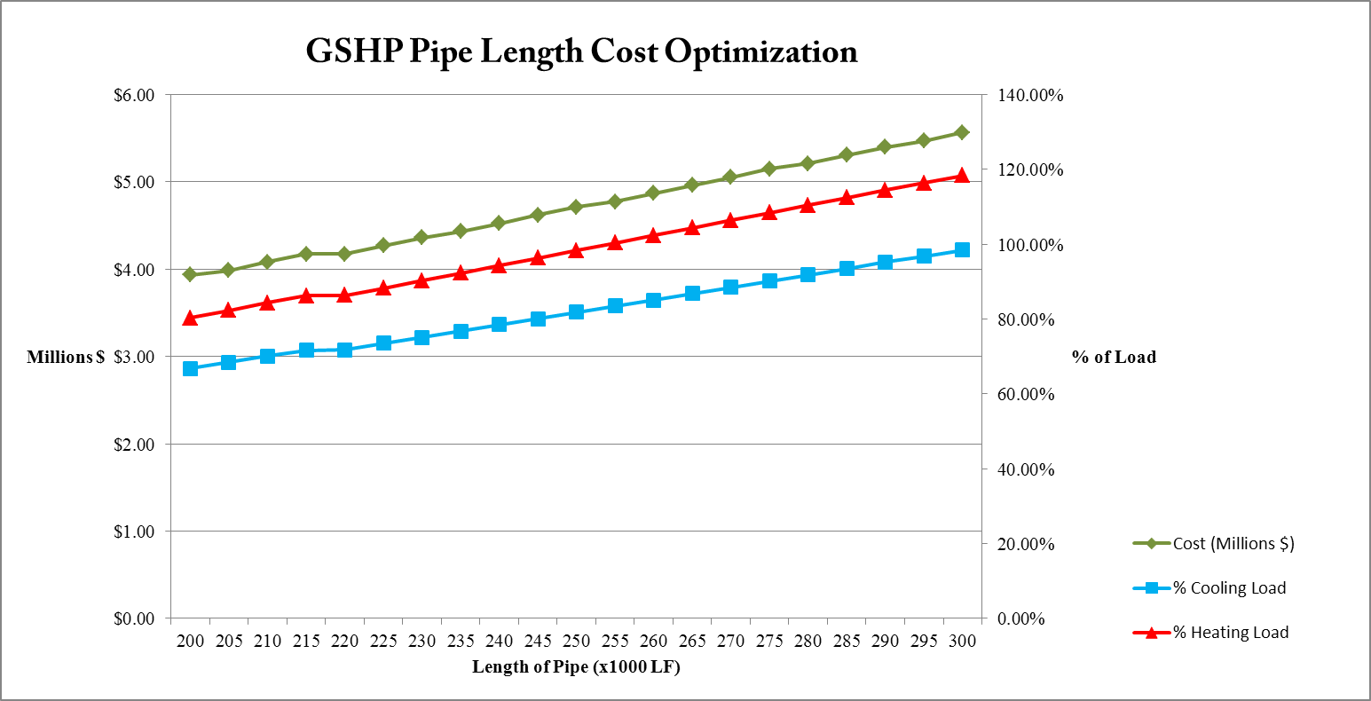
Length Optimization
  Length Optimization
  Construction Cost
  Life Cycle Cost Analysis
Construction Discussion Topics
Presentation Outline
  Introduction
Location, Statistics, General Information
  Actual Mechanical Design
System, Loads, Utility Costs
  Alternative Design
Mechanical Depth: GSHP
Electrical Breadth: PV Array
Construction Breadth: Cost Analysis
  The Final Analysis
Integration of Depths & Breadths
Final Recommendation
John M. Scavelli Mechanical Option Senior Thesis 2010-2011
The Pennsylvania State University: Department of Architectural Engineering
Master/Bachelor of Architectural Engineering Student

Slide 36
Length Optimization
  Length Optimization
  Construction Cost
  Life Cycle Cost Analysis
Construction Discussion Topics
Presentation Outline
  Introduction
Location, Statistics, General Information
  Actual Mechanical Design
System, Loads, Utility Costs
  Alternative Design
Mechanical Depth: GSHP
Electrical Breadth: PV Array
Construction Breadth: Cost Analysis
  The Final Analysis
Integration of Depths & Breadths
Final Recommendation
Provides over 100% of Heating Load
John M. Scavelli Mechanical Option Senior Thesis 2010-2011
The Pennsylvania State University: Department of Architectural Engineering
Master/Bachelor of Architectural Engineering Student

Slide 37

Length Optimization
  Length Optimization
  Construction Cost
  Life Cycle Cost Analysis
Construction Discussion Topics
Presentation Outline
  Introduction
Location, Statistics, General Information
  Actual Mechanical Design
System, Loads, Utility Costs
  Alternative Design
Mechanical Depth: GSHP
Electrical Breadth: PV Array
Construction Breadth: Cost Analysis
  The Final Analysis
Integration of Depths & Breadths
Final Recommendation
Provides over 100% of Heating Load
Unused Capacity
Under Capacity
John M. Scavelli Mechanical Option Senior Thesis 2010-2011
The Pennsylvania State University: Department of Architectural Engineering
Master/Bachelor of Architectural Engineering Student

Slide 38
Length Optimization
  Length Optimization
  Construction Cost
  Life Cycle Cost Analysis
Construction Discussion Topics
Presentation Outline
  Introduction
Location, Statistics, General Information
  Actual Mechanical Design
System, Loads, Utility Costs
  Alternative Design
Mechanical Depth: GSHP
Electrical Breadth: PV Array
Construction Breadth: Cost Analysis
  The Final Analysis
Integration of Depths & Breadths
Final Recommendation
Optimum Cost
Unused Capacity
Under Capacity
Supplement with/ Cooling Tower
John M. Scavelli Mechanical Option Senior Thesis 2010-2011
The Pennsylvania State University: Department of Architectural Engineering
Master/Bachelor of Architectural Engineering Student

Slide 39
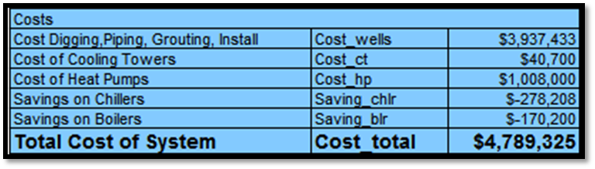
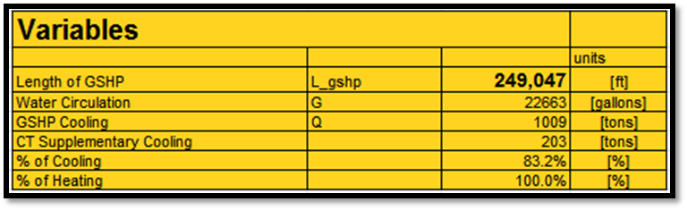
Construction Cost
  Length Optimization
  Construction Cost
  Life Cycle Cost Analysis
Construction Discussion Topics
Presentation Outline
  Introduction
Location, Statistics, General Information
  Actual Mechanical Design
System, Loads, Utility Costs
  Alternative Design
Mechanical Depth: GSHP
Electrical Breadth: PV Array
Construction Breadth: Cost Analysis
  The Final Analysis
Integration of Depths & Breadths
Final Recommendation
John M. Scavelli Mechanical Option Senior Thesis 2010-2011
The Pennsylvania State University: Department of Architectural Engineering
Master/Bachelor of Architectural Engineering Student

Slide 40
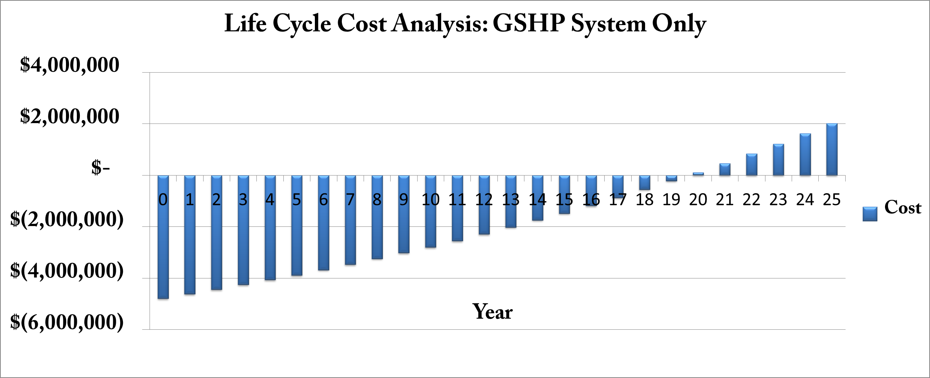
GSHP Life Cycle Cost Analysis
  Length Optimization
  Construction Cost
  Life Cycle Cost Analysis
Construction Discussion Topics
Presentation Outline
  Introduction
Location, Statistics, General Information
  Actual Mechanical Design
System, Loads, Utility Costs
  Alternative Design
Mechanical Depth: GSHP
Electrical Breadth: PV Array
Construction Breadth: Cost Analysis
  The Final Analysis
Integration of Depths & Breadths
Final Recommendation
John M. Scavelli Mechanical Option Senior Thesis 2010-2011
The Pennsylvania State University: Department of Architectural Engineering
Master/Bachelor of Architectural Engineering Student

Slide 41
  Yearly Cost Analysis: GSHP + PV System
  Life Cycle Cost Analysis: GSHP + PV System
  Pros vs. Cons
  Final Recommendations
The Final Analysis
Mechanical Depth:
East Campus
Ground Source Heat Pump System
Electrical Breadth:
Photovoltaic System
Construction Management Breadth:
GSHP Cost, Labor, Schedule Impact
Final Analysis
John M. Scavelli Mechanical Option Senior Thesis 2010-2011
The Pennsylvania State University: Department of Architectural Engineering
Master/Bachelor of Architectural Engineering Student

Slide 42
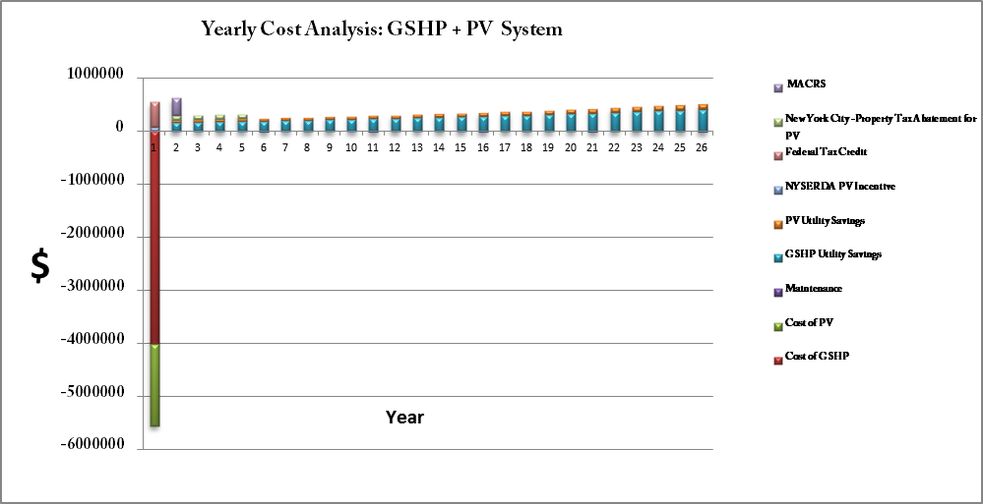
  Yearly Cost Analysis: GSHP + PV System
  Life Cycle Cost Analysis: GSHP + PV System
  Pros vs. Cons
  Final Recommendations
Yearly Cost Analysis: GSHP + PV System
Final Analysis
Presentation Outline
  Introduction
Location, Statistics, General Information
  Actual Mechanical Design
System, Loads, Utility Costs
  Alternative Design
Mechanical Depth: GSHP
Electrical Breadth: PV Array
Construction Breadth: Cost Analysis
  The Final Analysis
Integration of Depths & Breadths
Final Recommendation
John M. Scavelli Mechanical Option Senior Thesis 2010-2011
The Pennsylvania State University: Department of Architectural Engineering
Master/Bachelor of Architectural Engineering Student

Slide 43
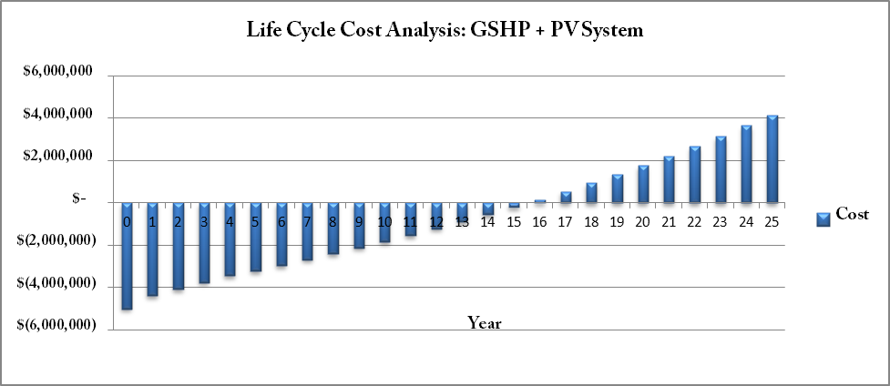
  Yearly Cost Analysis: GSHP + PV System
  Life Cycle Cost Analysis: GSHP + PV System
  Pros vs. Cons
  Final Recommendations
Life Cycle Cost Analysis
Final Analysis
Presentation Outline
  Introduction
Location, Statistics, General Information
  Actual Mechanical Design
System, Loads, Utility Costs
  Alternative Design
Mechanical Depth: GSHP
Electrical Breadth: PV Array
Construction Breadth: Cost Analysis
  The Final Analysis
Integration of Depths & Breadths
Final Recommendation
John M. Scavelli Mechanical Option Senior Thesis 2010-2011
The Pennsylvania State University: Department of Architectural Engineering
Master/Bachelor of Architectural Engineering Student

Slide 44
Pros vs. Cons
  Yearly Cost Analysis: GSHP + PV System
  Life Cycle Cost Analysis: GSHP + PV System
  Pros vs. Cons
  Final Recommendations
Final Analysis
Pros
Reduced Emissions
Reduced Utility Costs
Sustainable Landmark Building
Eliminate Natural Gas Consumption
Decrease Electricity Demand
Presentation Outline
  Introduction
Location, Statistics, General Information
  Actual Mechanical Design
System, Loads, Utility Costs
  Alternative Design
Mechanical Depth: GSHP
Electrical Breadth: PV Array
Construction Breadth: Cost Analysis
  The Final Analysis
Integration of Depths & Breadths
Final Recommendation
Cons
Increase in First Costs
Ground Temp Increase
Construction Difficulty
  Final Recommendations
    GSHP Implementation: Affirmative
    Photovoltaic Implementation: Affirmative
John M. Scavelli Mechanical Option Senior Thesis 2010-2011
The Pennsylvania State University: Department of Architectural Engineering
Master/Bachelor of Architectural Engineering Student

Slide 45

Thank You for Listening
Special Thanks to:
Turner Construction Company
Penn State Architectural Engineering Faculty, Staff, and Students
John M. Scavelli Mechanical Option Senior Thesis 2010-2011
The Pennsylvania State University: Department of Architectural Engineering
Master/Bachelor of Architectural Engineering Student

Slide 46
New York Police Academy
College Point, New York
Questions?
John M. Scavelli Mechanical Option Senior Thesis 2010-2011
The Pennsylvania State University: Department of Architectural Engineering
Master/Bachelor of Architectural Engineering Student

Slide 47
New York Police Academy
College Point, New York
Appendix
John M. Scavelli Mechanical Option Senior Thesis 2010-2011
The Pennsylvania State University: Department of Architectural Engineering
Master/Bachelor of Architectural Engineering Student

Slide 48
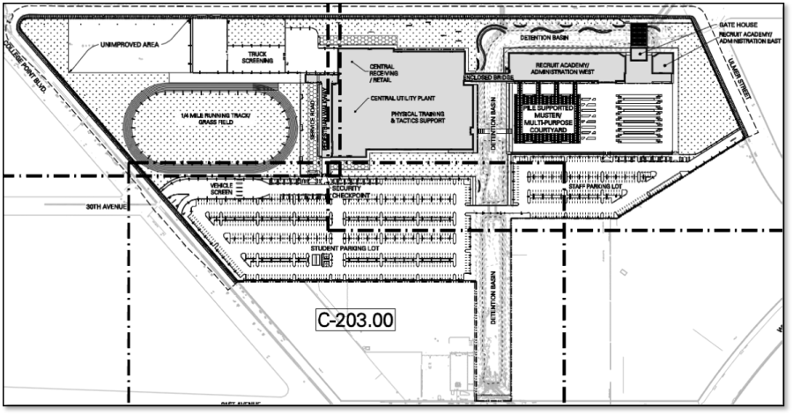
Well Field Layout
  Justification
  System Schematics
  Ground Source Heat Pump Loop Sizing
  Well Field Layout
  Energy Modeling
  Utility Cost Comparison
GSHP Major Discussion Topics
GSHP Design
Presentation Outline
  Introduction
Location, Statistics, General Information
  Actual Mechanical Design
System, Loads, Utility Costs
  Alternative Design
Mechanical Depth: GSHP
Electrical Breadth: PV Array
Construction Breadth: Cost Analysis
  The Final Analysis
Integration of Depths & Breadths
Final Recommendation
John M. Scavelli Mechanical Option Senior Thesis 2010-2011
The Pennsylvania State University: Department of Architectural Engineering
Master/Bachelor of Architectural Engineering Student

Slide 49
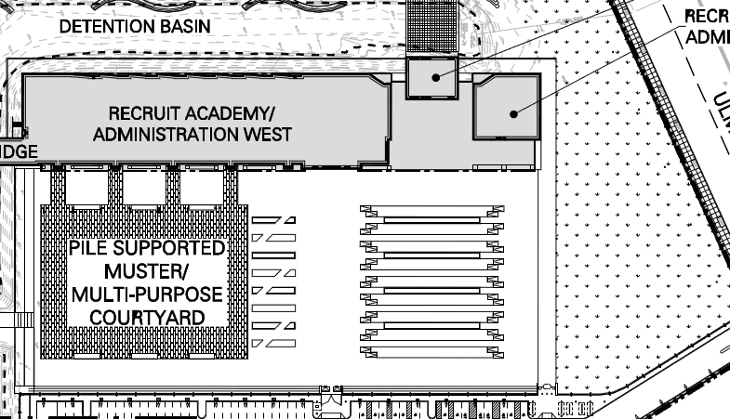
Well Field Layout
  Justification
  System Schematics
  Ground Source Heat Pump Loop Sizing
  Well Field Layout
  Energy Modeling
  Utility Cost Comparison
GSHP Major Discussion Topics
GSHP Design
Presentation Outline
  Introduction
Location, Statistics, General Information
  Actual Mechanical Design
System, Loads, Utility Costs
  Alternative Design
Mechanical Depth: GSHP
Electrical Breadth: PV Array
Construction Breadth: Cost Analysis
  The Final Analysis
Integration of Depths & Breadths
Final Recommendation
John M. Scavelli Mechanical Option Senior Thesis 2010-2011
The Pennsylvania State University: Department of Architectural Engineering
Master/Bachelor of Architectural Engineering Student

Slide 50
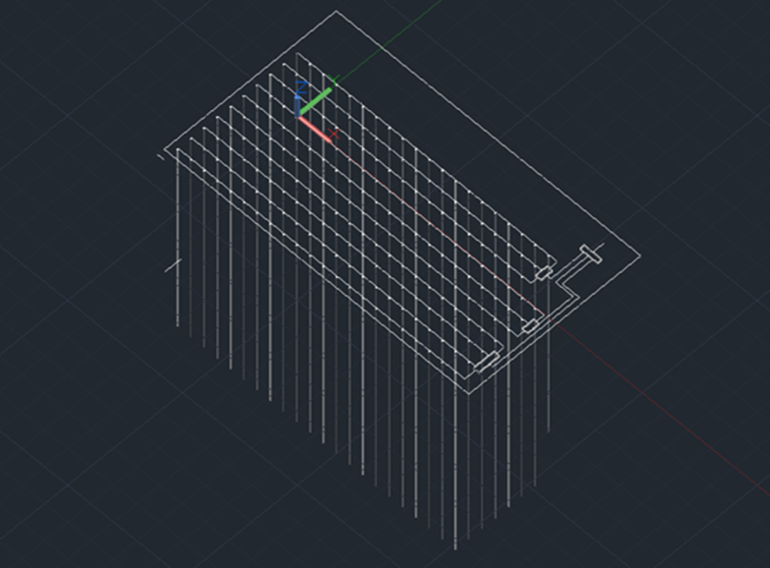
Well Field Layout
  214 Wells
  Depth 350’
  Two Loops per well
GSHP Design
Presentation Outline
  Introduction
Location, Statistics, General Information
  Actual Mechanical Design
System, Loads, Utility Costs
  Alternative Design
Mechanical Depth: GSHP
Electrical Breadth: PV Array
Construction Breadth: Cost Analysis
  The Final Analysis
Integration of Depths & Breadths
Final Recommendation
Well Field Layout
Row | # of Wells | Capacity
1 | 20 | 9.3%
2 | 20 | 9.3%
3 | 20 | 9.3%
Manifold 1 Total: | 60 | 28%
4 | 22 | 10.3%
5 | 22 | 10.3%
6 | 22 | 10.3%
Manifold 2 Total: | 66 | 31%
7 | 22 | 10.3%
8 | 22 | 10.3%
9 | 22 | 10.3%
10 | 22 | 10.3%
Manifold 3 Total: | 88 | 41%
John M. Scavelli Mechanical Option Senior Thesis 2010-2011
The Pennsylvania State University: Department of Architectural Engineering
Master/Bachelor of Architectural Engineering Student

Slide 51
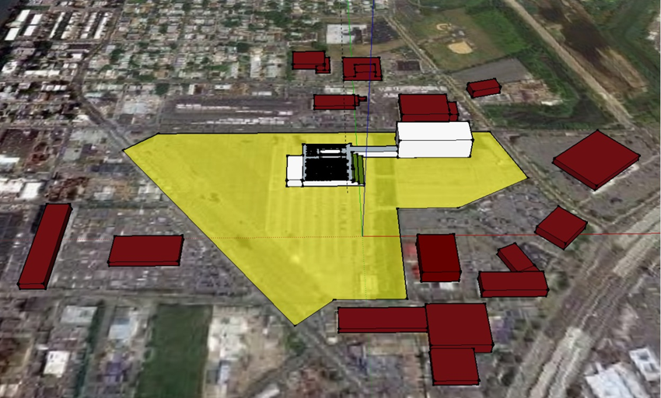
Array Placement
  Array Placement
  Array Size
  Panel Chosen, Mounting System Chosen
  Electrical Characteristics
    Strings, Inverter, Switchgear
  Economic Analysis
Photovoltaic System Discussion Topics
Presentation Outline
  Introduction
Location, Statistics, General Information
  Actual Mechanical Design
System, Loads, Utility Costs
  Alternative Design
Mechanical Depth: GSHP
Electrical Breadth: PV Array
Construction Breadth: Cost Analysis
  The Final Analysis
Integration of Depths & Breadths
Final Recommendation
John M. Scavelli Mechanical Option Senior Thesis 2010-2011
The Pennsylvania State University: Department of Architectural Engineering
Master/Bachelor of Architectural Engineering Student

Slide 52
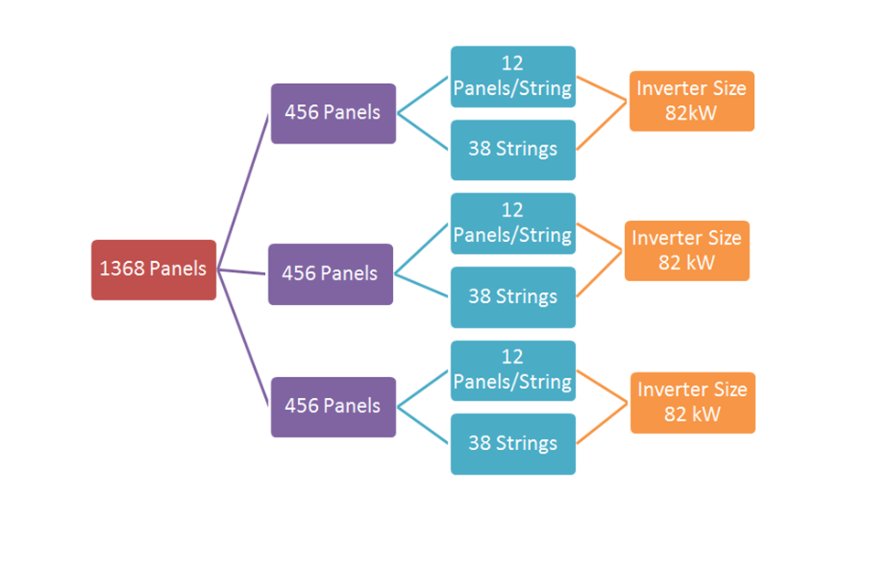
Electrical Schematic
  Array Placement
  Array Size
  Panel Chosen, Mounting System Chosen
  Electrical Characteristics
    Strings, Inverter, Switchgear
  Economic Analysis
Photovoltaic System Discussion Topics
Presentation Outline
  Introduction
Location, Statistics, General Information
  Actual Mechanical Design
System, Loads, Utility Costs
  Alternative Design
Mechanical Depth: GSHP
Electrical Breadth: PV Array
Construction Breadth: Cost Analysis
  The Final Analysis
Integration of Depths & Breadths
Final Recommendation
John M. Scavelli Mechanical Option Senior Thesis 2010-2011
The Pennsylvania State University: Department of Architectural Engineering
Master/Bachelor of Architectural Engineering Student

Slide 53
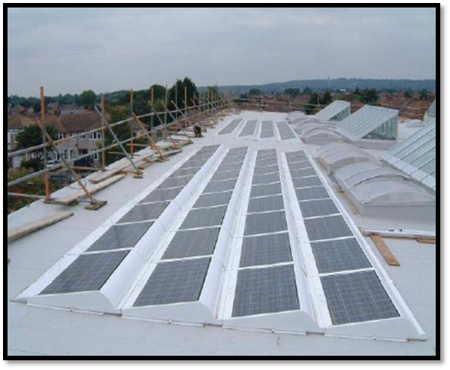
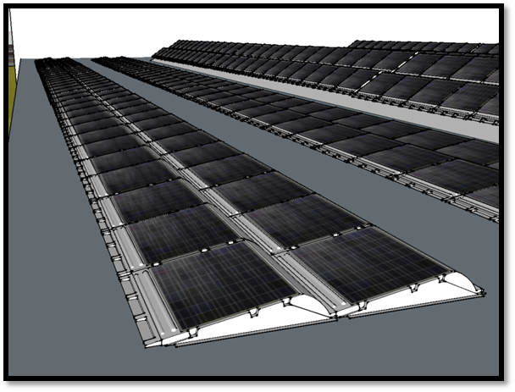
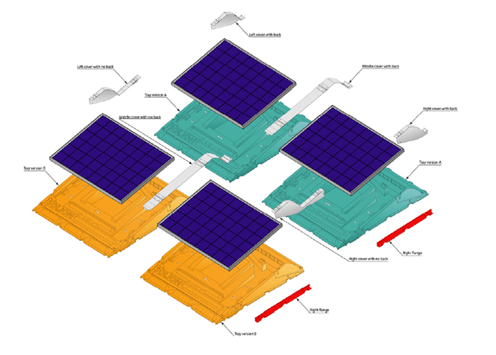
Panel and Mounting System
  Array Placement
  Array Size
  Panel Chosen, Mounting System Chosen
  Electrical Characteristics
    Strings, Inverter, Switchgear
  Economic Analysis
Photovoltaic System Discussion Topics
Presentation Outline
  Introduction
Location, Statistics, General Information
  Actual Mechanical Design
System, Loads, Utility Costs
  Alternative Design
Mechanical Depth: GSHP
Electrical Breadth: PV Array
Construction Breadth: Cost Analysis
  The Final Analysis
Integration of Depths & Breadths
Final Recommendation
  Sharp NU Series 185 W Panels
  Solion SunMount System
John M. Scavelli Mechanical Option Senior Thesis 2010-2011
The Pennsylvania State University: Department of Architectural Engineering
Master/Bachelor of Architectural Engineering Student

Slide 54
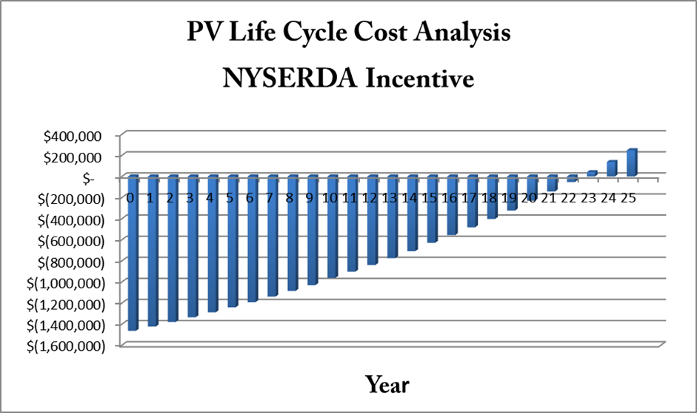
Economic Analysis
  Array Placement
  Array Size
  Panel Chosen, Mounting System Chosen
  Electrical Characteristics
    Strings, Inverter, Switchgear
  Economic Analysis
Photovoltaic System Discussion Topics
Presentation Outline
  Introduction
Location, Statistics, General Information
  Actual Mechanical Design
System, Loads, Utility Costs
  Alternative Design
Mechanical Depth: GSHP
Electrical Breadth: PV Array
Construction Breadth: Cost Analysis
  The Final Analysis
Integration of Depths & Breadths
Final Recommendation
John M. Scavelli Mechanical Option Senior Thesis 2010-2011
The Pennsylvania State University: Department of Architectural Engineering
Master/Bachelor of Architectural Engineering Student

Slide 55
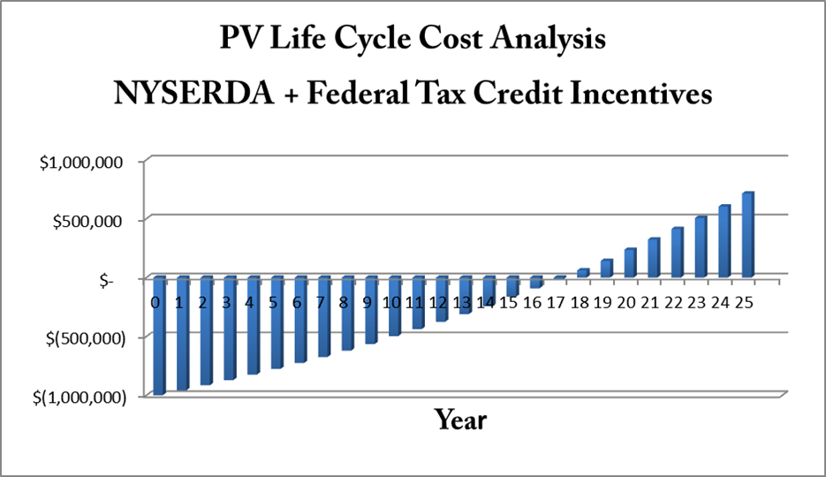
Economic Analysis
  Array Placement
  Array Size
  Panel Chosen, Mounting System Chosen
  Electrical Characteristics
    Strings, Inverter, Switchgear
  Economic Analysis
Photovoltaic System Discussion Topics
Presentation Outline
  Introduction
Location, Statistics, General Information
  Actual Mechanical Design
System, Loads, Utility Costs
  Alternative Design
Mechanical Depth: GSHP
Electrical Breadth: PV Array
Construction Breadth: Cost Analysis
  The Final Analysis
Integration of Depths & Breadths
Final Recommendation
John M. Scavelli Mechanical Option Senior Thesis 2010-2011
The Pennsylvania State University: Department of Architectural Engineering
Master/Bachelor of Architectural Engineering Student

Slide 56
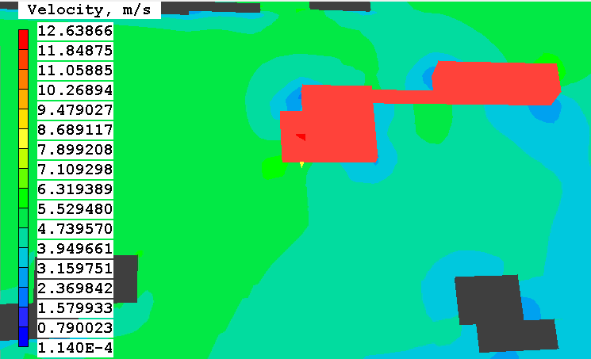
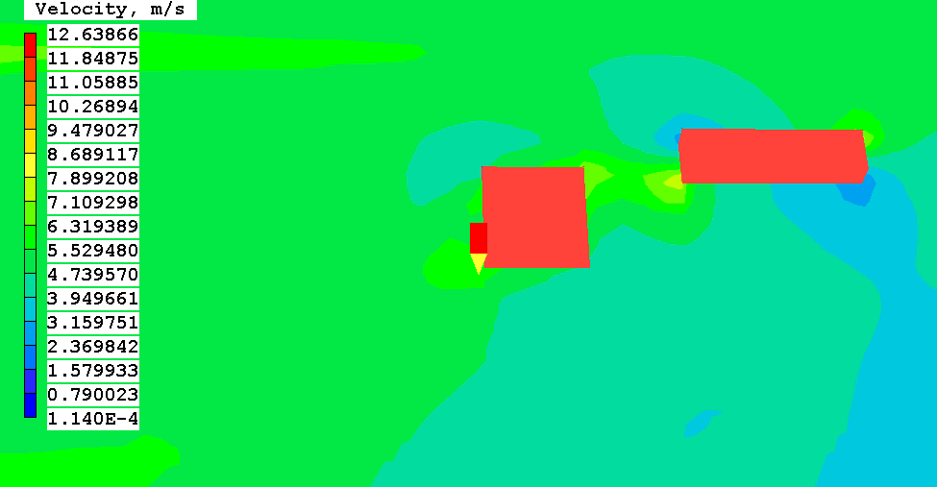
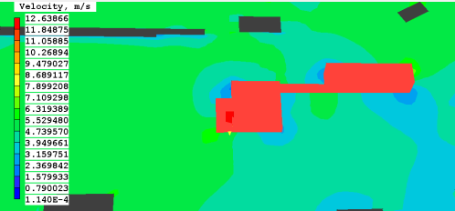
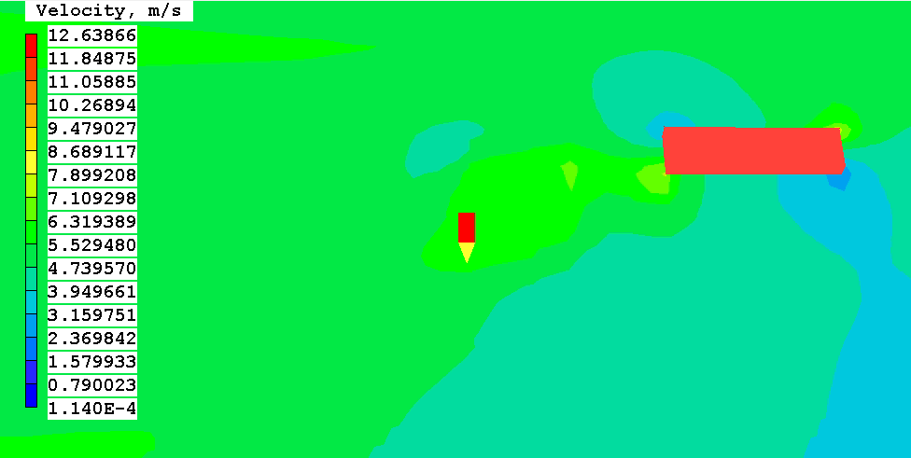
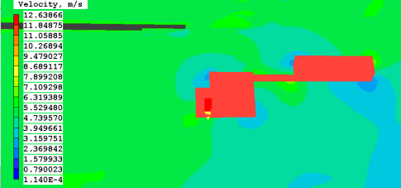

CFD Analysis
  Array Placement
  Array Size
  Panel Chosen, Mounting System Chosen
  Electrical Characteristics
    Strings, Inverter, Switchgear
  Economic Analysis
Photovoltaic System Discussion Topics
Presentation Outline
  Introduction
Location, Statistics, General Information
  Actual Mechanical Design
System, Loads, Utility Costs
  Alternative Design
Mechanical Depth: GSHP
Electrical Breadth: PV Array
Construction Breadth: Cost Analysis
  The Final Analysis
Integration of Depths & Breadths
Final Recommendation
0 meters
20 meters
5 meters
30 meters
10 meters
0 meters
John M. Scavelli Mechanical Option Senior Thesis 2010-2011
The Pennsylvania State University: Department of Architectural Engineering
Master/Bachelor of Architectural Engineering Student

Slide 57


CFD Analysis
  Array Placement
  Array Size
  Panel Chosen, Mounting System Chosen
  Electrical Characteristics
    Strings, Inverter, Switchgear
  Economic Analysis
Photovoltaic System Discussion Topics
Presentation Outline
  Introduction
Location, Statistics, General Information
  Actual Mechanical Design
System, Loads, Utility Costs
  Alternative Design
Mechanical Depth: GSHP
Electrical Breadth: PV Array
Construction Breadth: Cost Analysis
  The Final Analysis
Integration of Depths & Breadths
Final Recommendation
John M. Scavelli Mechanical Option Senior Thesis 2010-2011
The Pennsylvania State University: Department of Architectural Engineering
Master/Bachelor of Architectural Engineering Student

